Slide 1



SECRETARY
Rtr.SHIVANI GUPTA
2021-2022

Slide 2


Slide 3
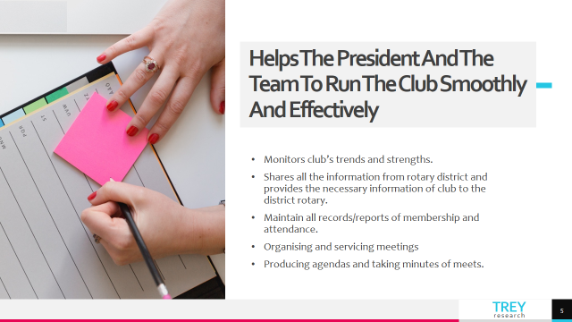

Slide 4


Slide 5
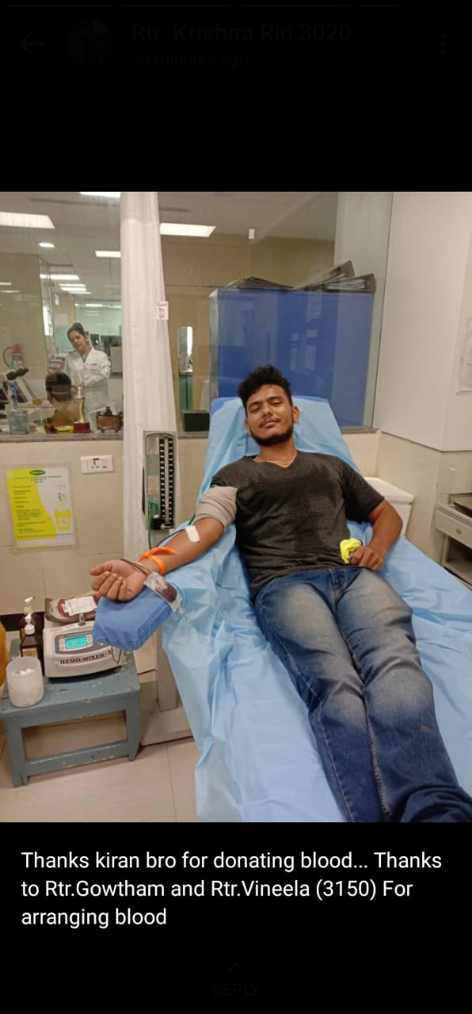

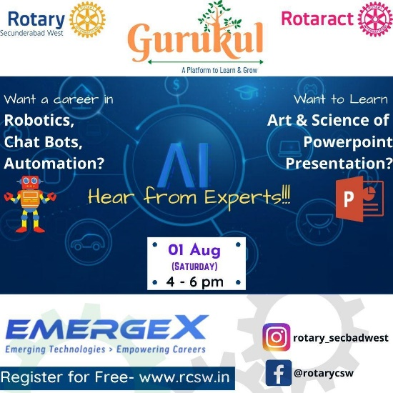

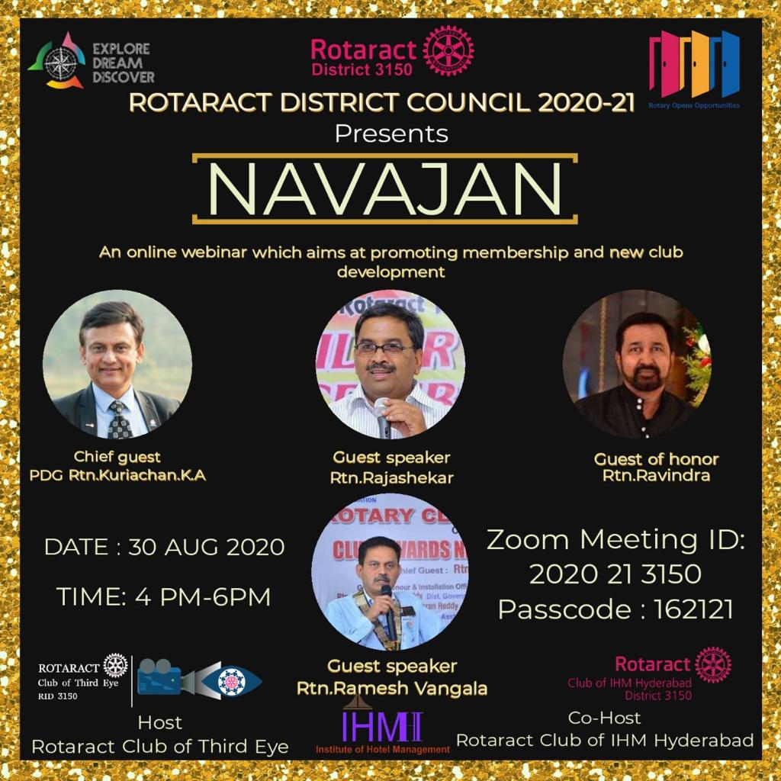
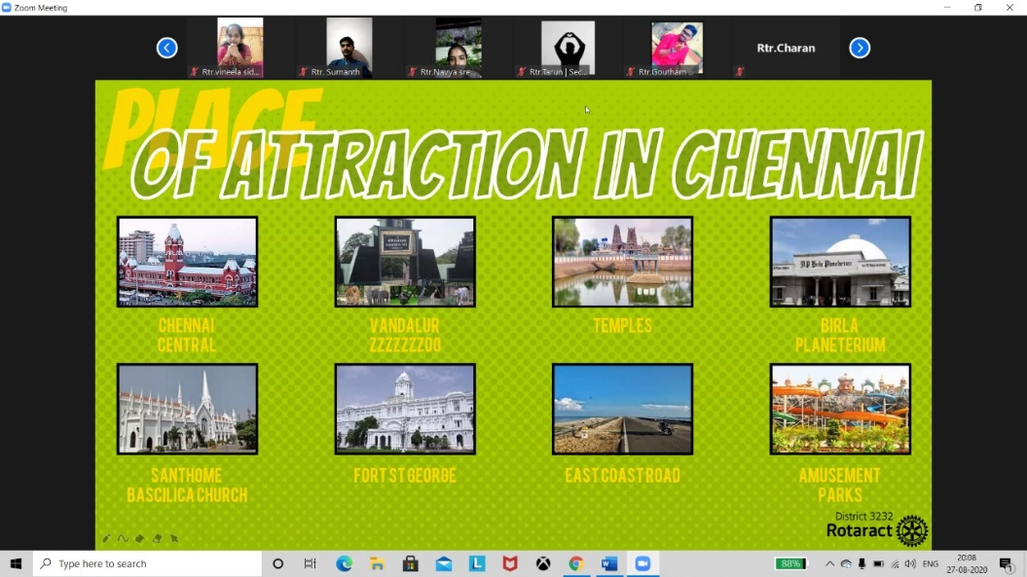


Slide 6
The activities include the following :
● EMERGEX ● NAVAJAN ● GANESH CHATURTHI OCCASION ● COMMUNITY SERVICES ● TOURS(VIRTUAL) ● ORIENTATION PROGRAMS

Slide 7
MY EXPERIENCES AND AQUAINTANCE THROUGH ROTARACT

Slide 8

WHY ROTARACT ?

Slide 9

Personal Growth
And Development
Interacting with leaders through out the world
Leadership
Development
Opportunities to
Learn new things
Fun And
Entertainment
Traveling opportunities
Social services

Slide 10




Slide 11


